Slide 1
Theory of Computation
CSE 3101
Lecture # 12
Md. Manowarul Islam
Lecturer, Dept of CSE
Jagannath University

Slide 2
At a glance….
DFA, NFA provide binary output
  They accept the string or they do not accept the string
This acceptability is decided on the basis of reach ability of the final state by the initial state.
Consider the model where the outputs can be chosen from some other alphabet.
Z(t)=λ (q(t),X(t))
  Z(t) is the output
  q(t) is present state
  X(t) is present input
  λ is the output function

Slide 3
Mealy and Moore Machine
Z(t)=λ (q(t),X(t))
This type of machine is called Mealy machine
  output depends on both the current state and the input symbol
Z(t)=λ (q(t))
This type of machine is called Moore machine
  output depends on the current state only

Slide 4
Moore Machine
Formal Definition
A Moore Machine is a 6-tuple M = (Q, Σ, Δ, δ, λ, q₀), where
Q is a finite set, whose elements are called states
Σ is a finite set, called the alphabet; the elements of Σ are called symbols
Δ is the output alphabet
δ : Q × Σ → Q is a function, called the transition function
λ is output function mapping Q into Δ
q₀ is an element of Q; it is called the start state

Slide 5
Mealy Machine
Formal Definition
A Mealy Machine is a 6-tuple M = (Q, Σ, Δ, δ, λ, q₀), where
Q is a finite set, whose elements are called states
Σ is a finite set, called the alphabet; the elements of Σ are called symbols
Δ is the output alphabet
δ : Q × Σ → Q is a function, called the transition function
λ is output function mapping Q × Σ into Δ
q₀ is an element of Q; it is called the start state

Slide 6
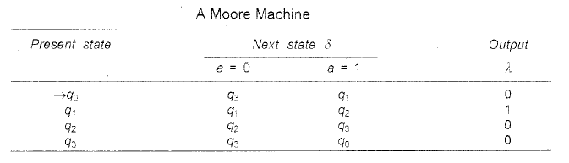
Moore Machine
λ is output function mapping Q into Δ
For the input string 0111 the transition of states is given by q₀ → q₃ → q₀ → q₁ → q₂
The output string is 00010.
For the input string ∧, the output is λ(q₀) = 0.

Slide 7
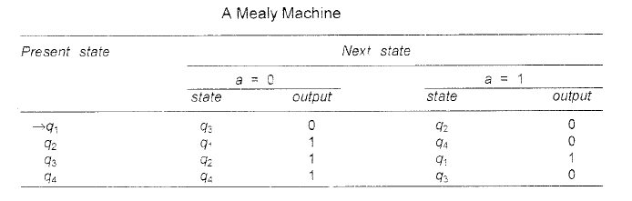
Mealy Machine
λ is output function mapping Q × Σ into Δ
For the input string 0011 the transition of states is given by q₁ → q₃ → q₂→ q₄→ q₃
The output string is 0100.

Slide 8
A theory
For a Moore machine if the input string is of length n, the output string is of length n + 1.
For a Moore machine if the input string is of length n, the output string is of length n
Did already

Slide 9
Moore Machine to Mealy Machine
Moore Machine to Mealy Machine
Algorithm 4
Input − Moore Machine
Output − Mealy Machine
Step 1 − Take a blank Mealy Machine transition table format.
Step 2 − Copy all the Moore Machine transition states into this table format.
Step 3 − Check the present states and their corresponding outputs in the Moore Machine state table; if for a state Q_{i} output is m, copy it into the output columns of the Mealy Machine state table wherever Q_{i} appears in the next state.

Slide 10
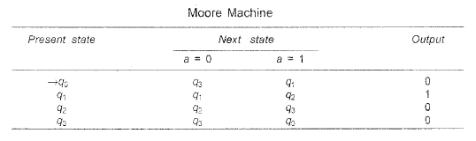
Moore Machine to Mealy Machine
Find the Mealy machine

Slide 11
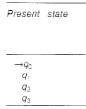
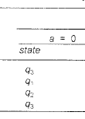
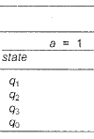


Moore Machine to Mealy Machine
  λ′(q,a)= λ(δ(q,a)) for all states q and input symbols a.

Slide 12
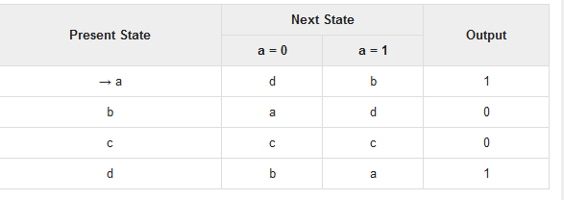
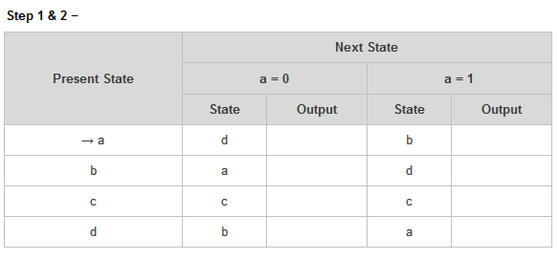
Example -2

Slide 13
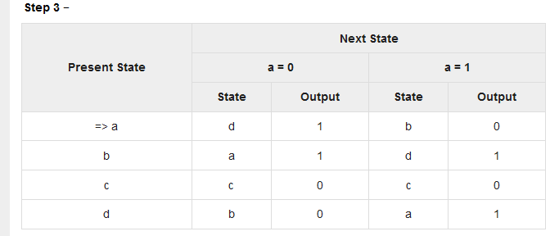
Example -2

Slide 14
Mealy Machine to Moore Machine
Find the Moore machine

Slide 15
Mealy Machine to Moore Machine
For any state, say q_{i}, determine the number of different outputs associated with q_{i}
Split q_{i} into several different states, the number of such states being equal to the number of different outputs associated with q_{i}
Reconstruct the Machine

Slide 16
Mealy Machine to Moore Machine
q₁ is associated with one output 1
q₂ is associated with two output 0 and 1
  we split q₂ into q₂₀ and q₂₁
  we split q₄ into q₄₀ and q₄₁

Slide 17
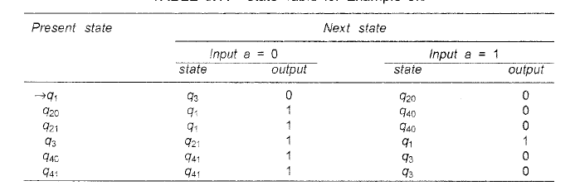
Mealy Machine to Moore Machine

Slide 18

Mealy Machine to Moore Machine
Add the output

Slide 19

Mealy Machine to Moore Machine
Omit the second column at each input

Slide 20
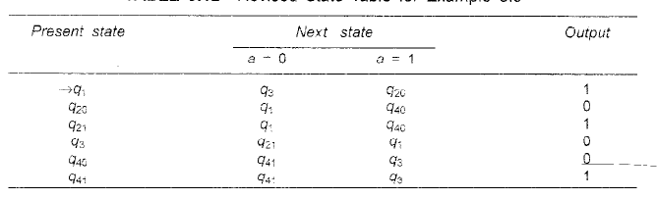
Mealy Machine to Moore Machine
Finally

Slide 21
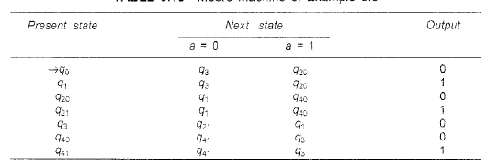
Mealy Machine to Moore Machine
q₁ is associated with one output 1 in mealy machine
  with input ∧ we get an output of 1
  accepts a zero length sequence (null sequence) which is not accepted by the Mealy machine
with we must add a new starting state q₀, whose state transitions are identical with those of q₁ but whose output is 0.

Slide 22
END

